Slide 1

Stock Market Prediction

Slide 2
Team Members:
Toqeer Zafar
Syed Muhammad Noman Ali Shah
Abdullah Ejaz

Slide 3

Introduction:
A stock exchange is a place where people buy and sell stocks, bonds, and other financial products. It helps show how well an economy is doing. In the past, stock exchanges were physical buildings, but now many have moved to online platforms. Despite this, they are still important and can be worth trillions of dollars. There is total 60 stock exchanges

Slide 4

Largest five with market cap:
1) New York Stock Exchange (NYSE), US – $25.24T
2) NASDAQ, United States – $20.58T
[3) Shanghai Stock Exchange (SSE), China – $6.6T
4) EURONEXT, Europe – $6.26T
5) Japan Stock Exchange (JPX) – $5.75T

Slide 5
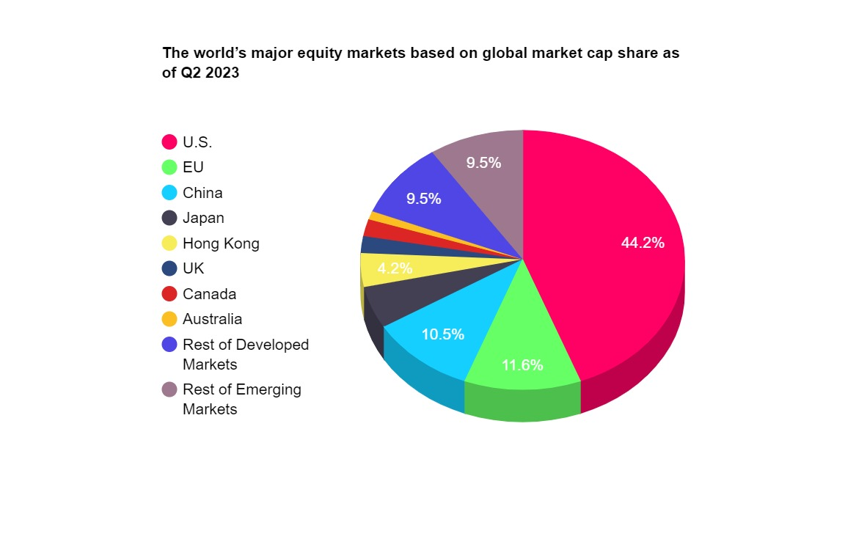
Largest five with market cap:

Slide 6

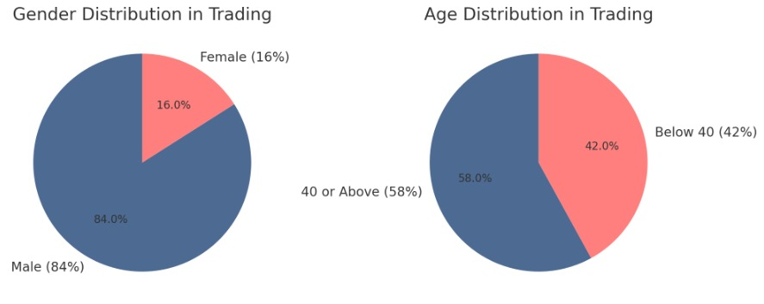
Demo graph Gender based on age

Slide 7
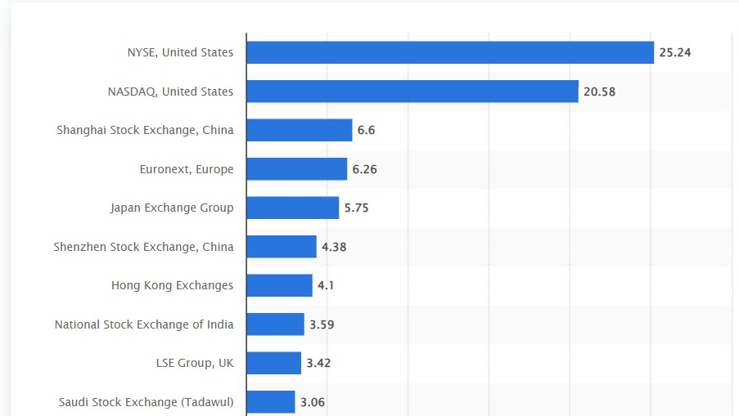
Largest market by capitalization

Slide 8

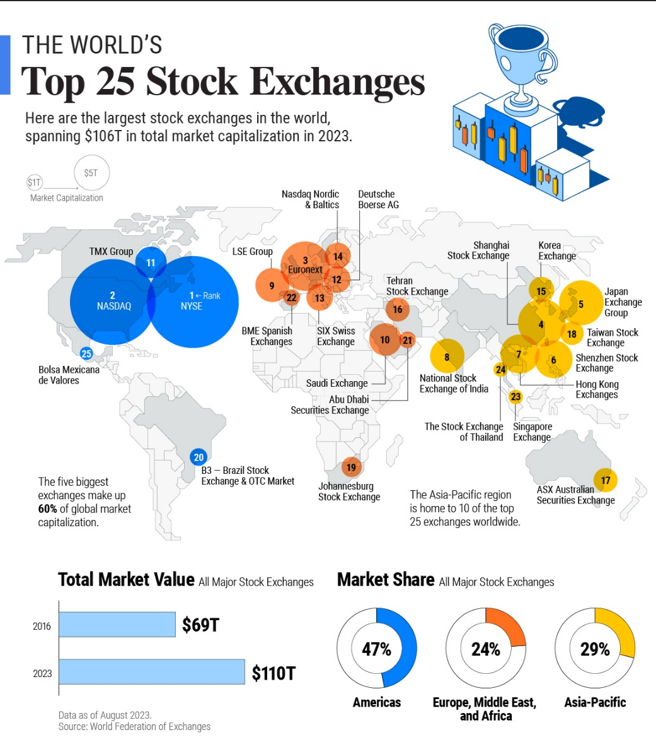
Trillion dollar club

Slide 9
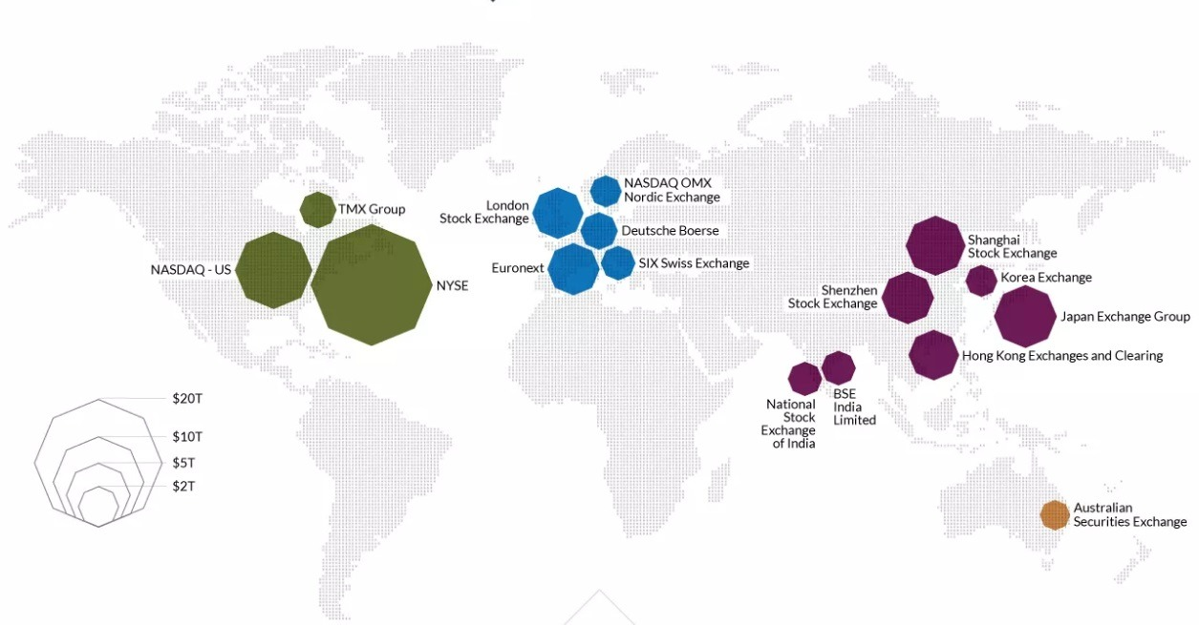

Slide 10
Confidence Interval:
Assumption: we will take 95% as confidence level, so:
a = 0.05
1 – α = 0.95
Confidence interval for Opening Price:
619.079 < μo < 644.74
Confidence interval for Closing Price:
618.61 < μp < 648.28

Slide 11
Confidence Interval:
Confidence interval for Highest Price:
631.15 < μh < 661.61
Confidence interval for Lowest Price:
6.6.38 < μl < 630.66
Confidence interval for Change in Prices:
-0.43 < μc < 2.33

Slide 12
Continuous Distribution:
Average High rice of a company = A = 646.378
Average Low price of a company = B = 618.77
Interval [618.77, 646.378]
Probability Density Function:
f(x,618.77,646.378) = 1/(646.378 – 618.77)
= 0.036

Slide 13
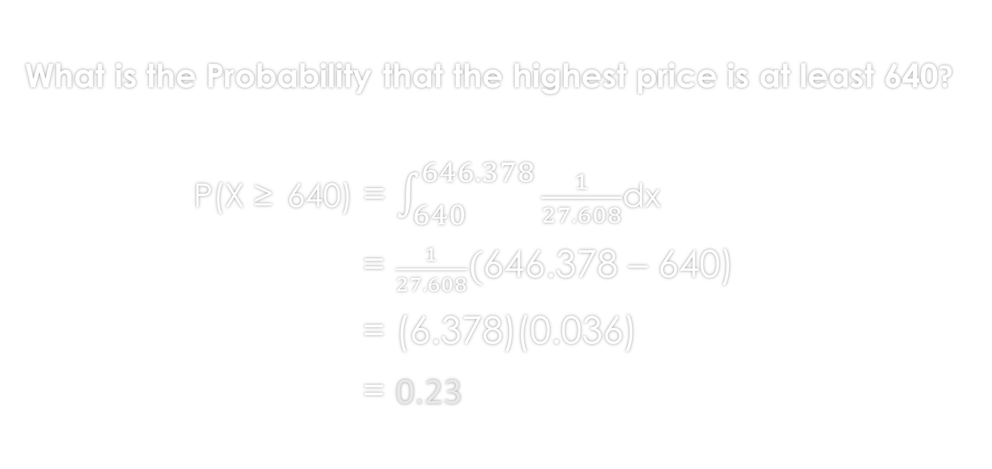
Continuous Distribution:
What is the Probability that the highest price is at least 640?
P(X ≥ 640) = $\int_{640}^{646.378}{\frac{1}{27.608}}$dx
= $\frac{1}{27.608}(\text{646.378 – 640}\text{)}$
= (6.378)(0.036)
= 0.23

Slide 14
Observation # 1:
Is opening price and closing price are significantly close within a specific range?
H0 : μo – μp = 10
H1 : μo – μp > 10
tcal > ttab = 1.21 > 1.680(False)
Conclusion:
After testing both hypotheses, we accepted Null hypothesis and rejected Alternative hypothesis.

Slide 15
Observation # 2:
Is highest price and lowest prices of a day are close within a specific range?
H0 : μh – μl = 50
H1 : μh – μl > 50
tcal > ttab = 2.39 > 1.680 (True)
Conclusion:
After testing both hypotheses, we accepted Alternative hypothesis and rejected Null hypothesis.

Slide 16
Observation # 3:
Is mean difference of daily highest prices and closing prices of a day close within a specific range?
H0 : μo – μp = 20
H1 : μo – μp > 20
tcal > ttab = 3.12 > 1.680 (True)
Conclusion:
After testing both hypotheses, we accepted Alternative hypothesis and rejected Null hypothesis.

Slide 17
Observation # 4:
Is mean difference of daily opening prices and closing prices close within a specific range?
H0 : μo – μp = 10
H1 : μo – μp < 10
tcal < ttab = 0.371 < 1.680 (True)
Conclusion:
After testing both hypotheses, we accepted Alternative hypothesis and rejected Null hypothesis.

Slide 18
Observation # 5:
Is the mean of daily Lowest price is greater then 30?
H0 : μl = 600
H1 : μl > 600
tcal > ttab = 3.26 > 1.717 (True)
Conclusion:
After testing both hypotheses, we accepted Alternative hypothesis and rejected Null hypothesis.

Slide 19
Observation # 6:
Is the proportion of positive change is smaller than 0.65?
H0 : p = 0.65
H1 : p < 0.65
|Zcal| <|Ztab| = 0.40 < 1.64 (True)
Conclusion:
After testing both hypotheses, we accepted Alternative hypothesis and rejected Alternative hypothesis.

Slide 20
Observation # 7:
Is the 80% of Closing price is at most 0.80?
H0 : p = 0.80
H1 : p > 0.80
Zcal > Ztab = 1.31 > 0.84 (True)
Conclusion:
After testing both hypotheses, we accepted Alternative hypothesis and rejected Null hypothesis.

Slide 21
Observation # 8:
Is the proportion of High-Low Difference more than Rs.30 of two samples are same?
H0 : p1 = p2
H1 : p1 ≠ p2
Zcal < Ztab = 0 < -1.64 (False)
Conclusion:
After testing both hypotheses, we accepted Null hypothesis and rejected Alternative hypothesis.

Slide 22
Observation # 9:
Is the mean of change is less than 0.5%?
H0 : μc = 0.5
H1 : μc < 0.5
tcal < ttab = 0.67 < 2.074 (true)
Conclusion:
After testing both hypotheses, we accepted Alternative hypothesis and rejected Null hypothesis.

Slide 23
Observation # 10:
Is the daily change of prices has negative change less than 0.4%?
H0 : p = 0.4
H1 : p < 0.4
Zcal < Ztab = 0.78 < -1.64 (False)
Conclusion:
After testing both hypotheses, we accepted Null hypothesis Ho and rejected Alternative hypothesis.

Slide 24
Conclusion:
Significant differences were observed between high and low prices.
but no significant differences were observed between closing and high prices, indicating price variability across trading days.
The daily opening and close prices were also shown to deviate significantly, demonstrating fluctuations within the trading day.
For proportions, it was concluded that the proportion of positive price changes is at least 0.65, highlighting a potential downward trend in stock movements.
However, no significant difference was found in the proportions of high-low differences for two samples, suggesting stability in this metric across samples.

Slide 25
Conclusion:
Overall, the results suggest a dynamic trading environment with significant intra-day and inter-day price variations, while some metrics, such as high-low differences, remain consistent across samples. These findings can help inform trading strategies and risk management decisions.

Slide 26
End

